Slide 1

E - Commerce Recommendation pipeline
Batch 19 - Section 4
Team members
Roll No Name
2420030427 Y. Nimisha
2420030498 K. Sanuhya
2420030516 R. Sarvajith varma
Under the guidance of
Dr. Nalla Shirisha
Associate Professor
Department of Computer Science and Engineering
Koneru Lakshmaiah Education Foundation
(Deemed to be University estd. u/s. 3 of the UGC Act, 1956)
Off-Campus: Bachupally-Gandimaisamma Road, Bowrampet, Hyderabad, Telangana - 500 043.
Phone No: 7815926816, www.klh.edu.in

Slide 2
Table of contents
Abstract
Introduction
Objectives
Existing system
Limitations of Existing System
Proposed System
Literature Survey
Software Requirements
Hardware Requirements
Functional Requirements
Non-Functional Requirements

Slide 3
Table of contents
System architecture
UML Diagrams
Methodology
Technologies used
Implementation(code)
Flow Diagram/Functionality
Results
Comparison
Conclusion
References

Slide 4
Abstract
E-commerce platforms provide a very large number of products, which can make it difficult for customers to find products that match their needs and interests. To solve this problem, recommendation systems study different types of user activities, such as searches, clicks, product views, ratings, cart activity, and previous purchases. These activities help the system understand what a customer is interested in. The collected information is then processed through a recommendation pipeline, where the data is collected, cleaned, prepared, and analyzed. Based on this processed data, suitable products are identified, ranked according to their relevance, and recommended to the customer. The recommendations are personalized because they are based on the individual customer's interests and behavior. This project focuses on understanding how an e-commerce recommendation system works, the different stages involved in its data pipeline, and how these personalized recommendations can improve product discovery, customer experience, and make online shopping easier and more convenient.

Slide 5
Introduction
E-commerce has become a major part of everyday shopping, with platforms offering thousands or even millions of products. With so many choices available, customers may find it difficult to identify products that are relevant to their needs.
An e-commerce recommendation system helps solve this problem by understanding customer interests and suggesting products that they are likely to prefer. It uses information such as search history, product views, clicks, ratings, cart activity, and previous purchases.
Behind these recommendations is a recommendation pipeline. It takes user and product data, processes the information, finds relevant products, ranks them, and finally displays the most suitable recommendations to the customer.
Therefore, recommendation systems help make online shopping more personalized, convenient, and efficient, while also helping e-commerce platforms improve customer engagement and product discovery.

Slide 6
Objectives
Understand the working of e-commerce recommendation systems
Collect user and product activity data
Process and clean recommendation data
Analyze user interests and preferences
Generate relevant product recommendations
Rank products based on user behavior
Provide personalized recommendations
Improve product discovery and customer experience

Slide 7
Existing System
E-commerce platforms provide a large number of products to customers. Traditional systems mainly display products based on general popularity, categories, or basic search results.
Some recommendation systems use user activities such as product views, clicks, ratings, cart activity, and previous purchases to identify customer interests. However, the recommendation process depends on how effectively this user and product data is collected, processed, analyzed, and used.
The existing approach may not always provide highly personalized recommendations for every customer.

Slide 8
Limitations of Existing System
Large number of products can make product selection difficult.
Generic recommendations may not match individual customer interests.
User preferences can change over time.
Raw user activity data may contain missing or unnecessary information.
Processing large amounts of user activity can be challenging.
New users and new products may have limited interaction data.
Ranking relevant products accurately can be difficult.
Poor recommendations can reduce product discovery and user experience.

Slide 9
Proposed System
The proposed system focuses on an E-Commerce Recommendation Pipeline that processes customer and product activity to generate personalized product recommendations.
The system collects information such as searches, product views, clicks, ratings, cart activity, and previous purchases. The collected data is cleaned and prepared before analyzing customer interests and preferences.
Based on the processed data, suitable products are identified and ranked according to user behavior and product relevance. The final recommendations are then presented to the customer.
The proposed pipeline helps improve personalization, product discovery, and customer experience.

Slide 10
Literature Survey
S.No | Research Paper | Author(s) | Actual Link | Drawback
1. | Toward the Next Generation of Recommender Systems: A Survey | Gediminas Adomavicius, Alexander Tuzhilin | https://doi.org/10.1109/TKDE.2005.99 | Provides a broad overview of recommendation techniques, but does not focus on one specific e-commerce application. (Wikipedia)
2. | Amazon.com Recommendations: Item-to-Item Collaborative Filtering | Greg Linden, Brent Smith, Jeremy York | https://doi.org/10.1109/MIC.2003.1167344 | Works well for large-scale recommendations, but mainly focuses on item-to-item relationships and may not fully capture complex user preferences. (IEEE Xplore)
3. | Collaborative Filtering for Implicit Feedback Datasets | Yifan Hu, Yehuda Koren, Chris Volinsky | https://doi.org/10.1109/ICDM.2008.22 | Uses implicit user feedback such as views and purchases, but implicit feedback does not always indicate whether a user actually liked a product. (CiNii Research)
4. | Matrix Factorization Techniques for Recommender Systems | Yehuda Koren, Robert Bell, Chris Volinsky | https://doi.org/10.1109/MC.2009.263 | Provides effective recommendations, but matrix factorization can have difficulty with new users or new products due to the cold-start problem. (OA Monitor Ireland)
5. | Deep Neural Networks for YouTube Recommendations | Paul Covington, Jay Adams, Emre Sargin | https://doi.org/10.1145/2959100.2959190 | Uses deep learning for candidate generation and ranking, but requires large amounts of data and computational resources. (DOI)
6. | Neural Collaborative Filtering | Xiangnan He, Lizi Liao, Hanwang Zhang, Liqiang Nie, Xia Hu, Tat-Seng Chua | https://doi.org/10.1145/3038912.3052569 | Improves recommendation using neural networks, but the model is more complex and requires more computation than traditional methods. (ACM Digital Library)

Slide 11
Software Requirements
Operating System: Windows / Linux
Programming Language: Python
Development Environment: Jupyter Notebook
Libraries: Pandas, NumPy, Scikit-learn
Data Processing: Pandas
Numerical Analysis: NumPy
Machine Learning: Scikit-learn
Data Visualization: Matplotlib / other visualization tools
These tools are used for data processing, analysis, recommendation logic, experimentation, and testing.

Slide 12
Hardware Requirements
Processor: Intel Core i3 or equivalent and above
RAM: Minimum 4 GB
Storage: Minimum 10 GB free space
Display: Standard monitor
Input Devices: Keyboard and mouse
Internet Connection: Required for accessing datasets and online development resources
The system does not require specialized hardware because the recommendation pipeline can be developed and tested on a standard computer.

Slide 13
Functional Requirements
The system should:
Collect user activity data.
Collect product-related information.
Store and process user interactions.
Clean and preprocess the collected data.
Analyze customer interests and preferences.
Identify relevant products.
Generate product recommendations.
Rank products based on user behavior and relevance.
Display personalized product suggestions.
Support improved product discovery.

Slide 14
Non-Functional Requirements
Performance: The system should process recommendation data efficiently.
Scalability: The pipeline should be capable of handling increasing amounts of user and product data.
Reliability: The system should provide consistent recommendations for available user data.
Usability: Recommendations should be easy for customers to understand and use.
Maintainability: The implementation should be structured and easy to modify.
Accuracy: Recommended products should be relevant to user interests.
Efficiency: Data preprocessing and recommendation generation should be performed efficiently.

Slide 15
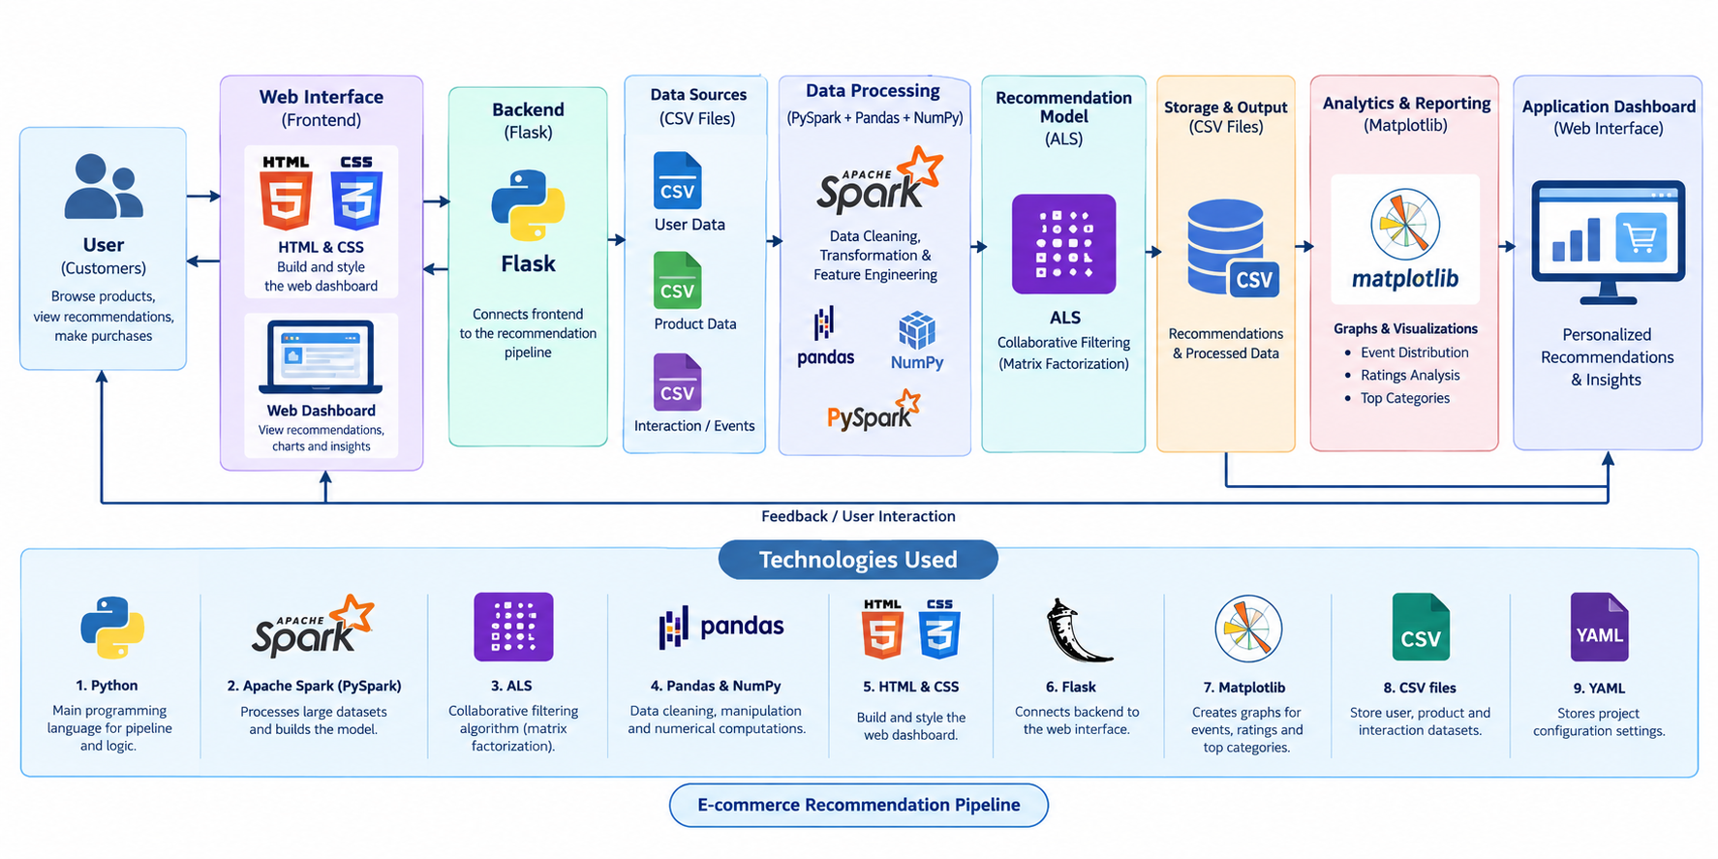
System Architecture

Slide 16
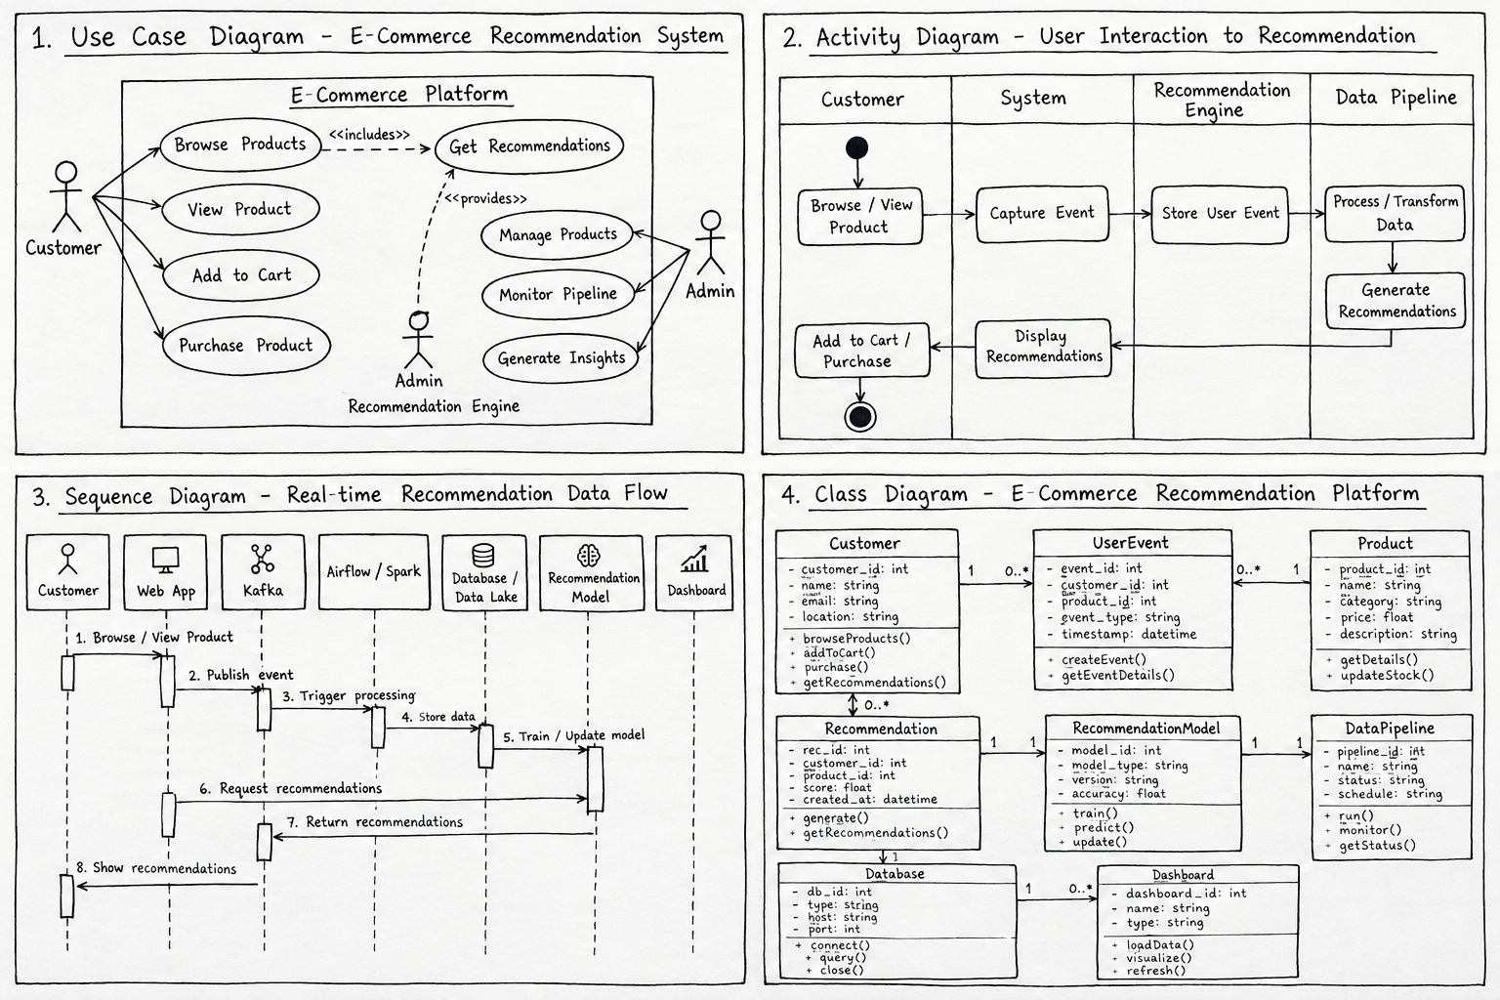
UML Diagram

Slide 17
Methodology
Collect user and product activity data:
Gather information about user interactions, product details, views, clicks, and purchase history.
Clean and preprocess the data:
Remove missing values, duplicates, and unnecessary data. Convert the data into a suitable format for analysis.
Analyze customer interests and preferences:
Study user behavior to understand their interests and identify products they may prefer.
Generate and rank relevant product recommendations:
Use recommendation algorithms to find suitable products and rank them based on user preferences and product relevance.
Display personalized recommendations:
Present the recommended products to users through the e-commerce platform to improve product discovery and shopping experience.

Slide 18
Technologies and Tools
1. Python
Main programming language for data processing and recommendation logic.
2. Apache Spark (PySpark)
Processes large datasets and builds the recommendation model.
3. ALS (Alternating Least Squares)
Collaborative filtering algorithm used to recommend products based on user interactions.(matrix factorization model)
4. Pandas and NumPy
Data cleaning, manipulation, and numerical computations.
5. HTML and CSS
Build and style the web dashboard.
6. Flask
Connects the backend recommendation pipeline to the web interface.
7. Matplotlib
Creates graphs for event distribution, ratings, and top product categories.
8. CSV files
Store user, product, and interaction datasets.
9. YAML
Stores project configuration settings.

Slide 19
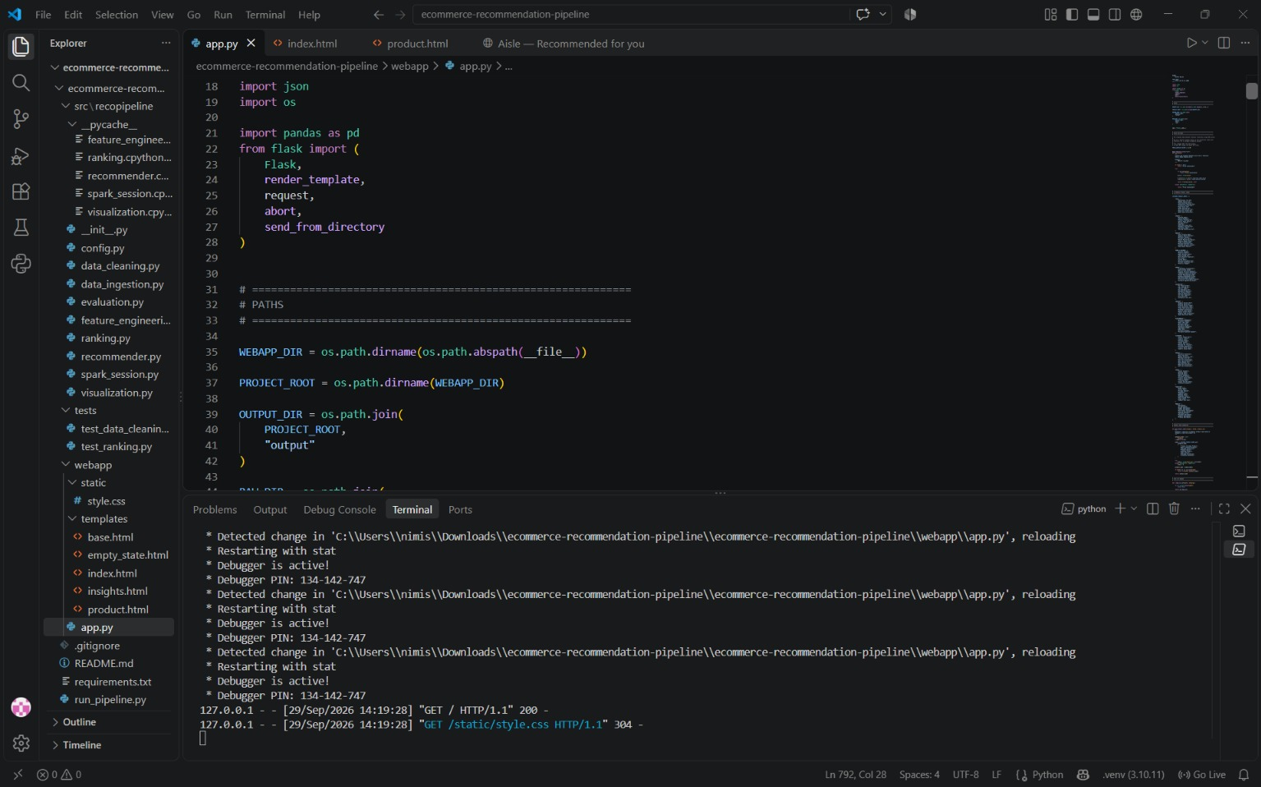
Implementation

Slide 20
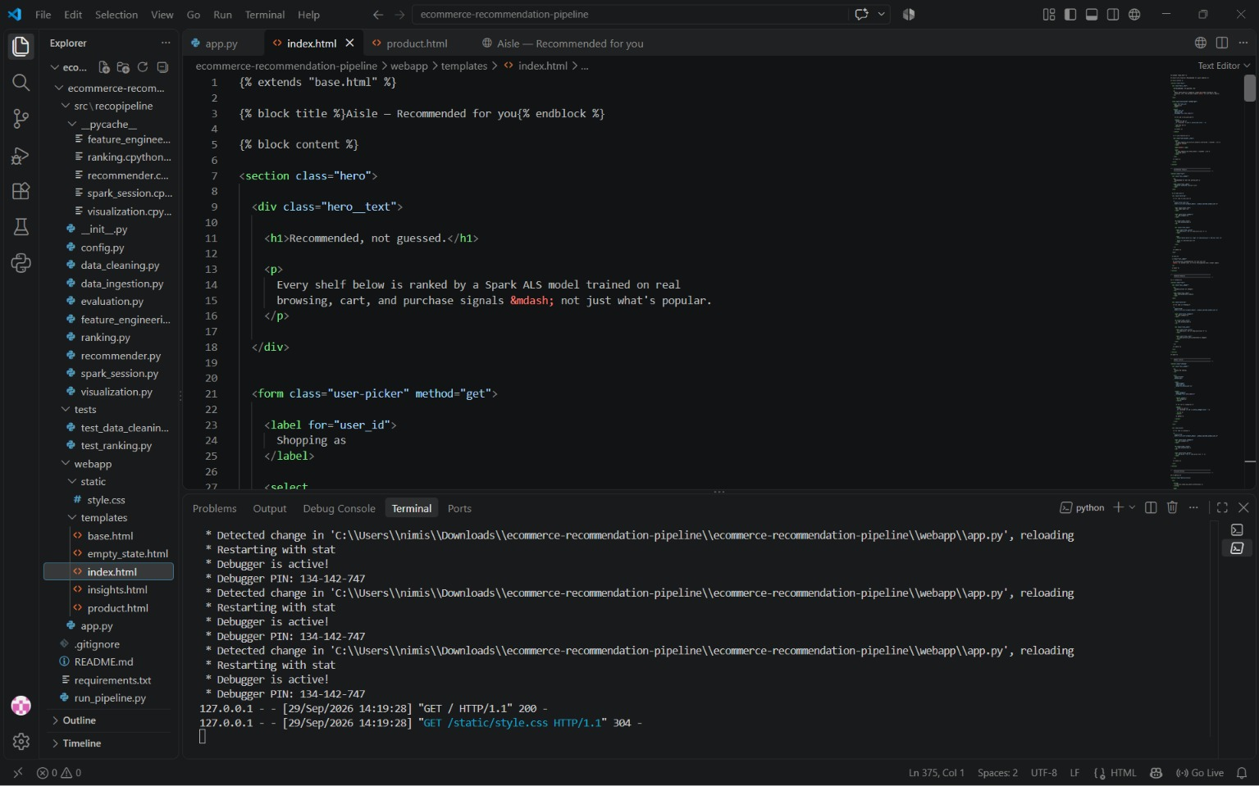
Implementation

Slide 21
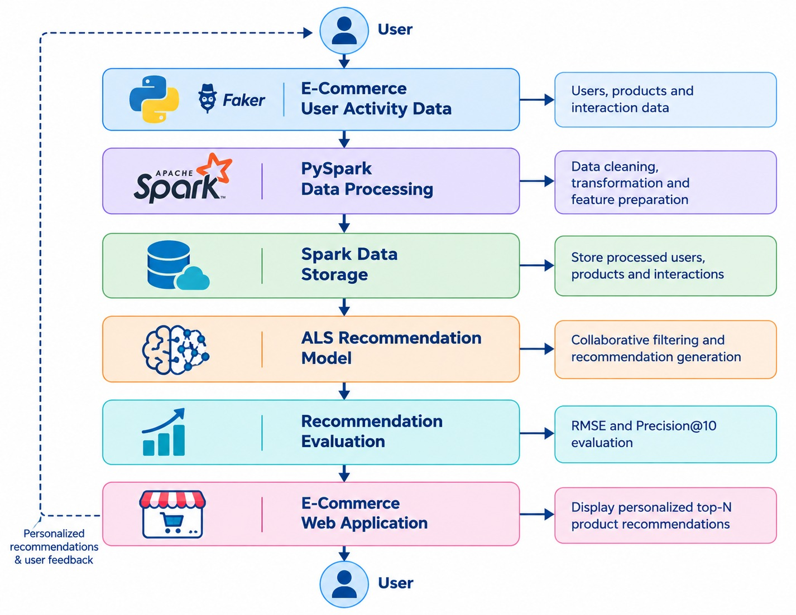
Functionality/Flow Diagram

Slide 22
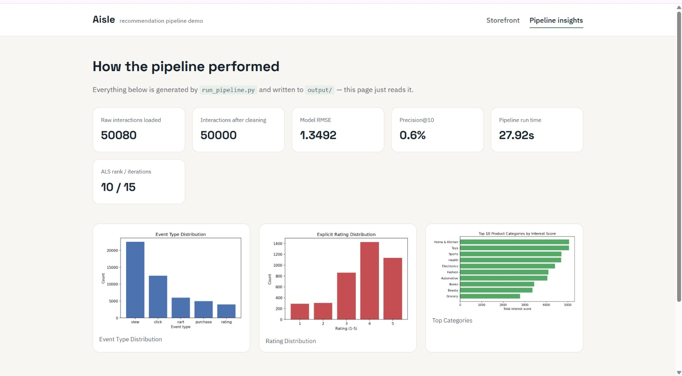
Results

Slide 23
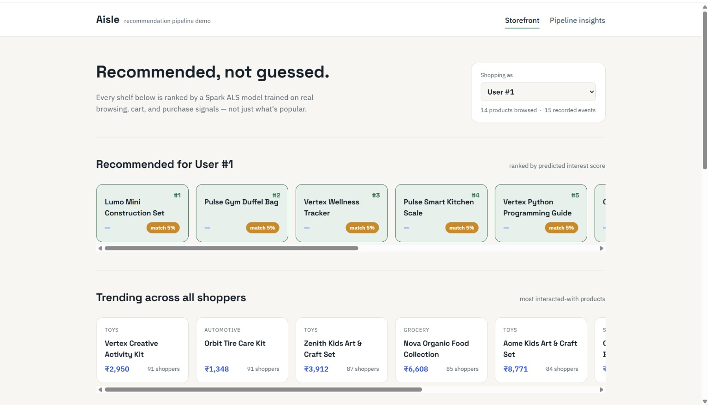
Results

Slide 24
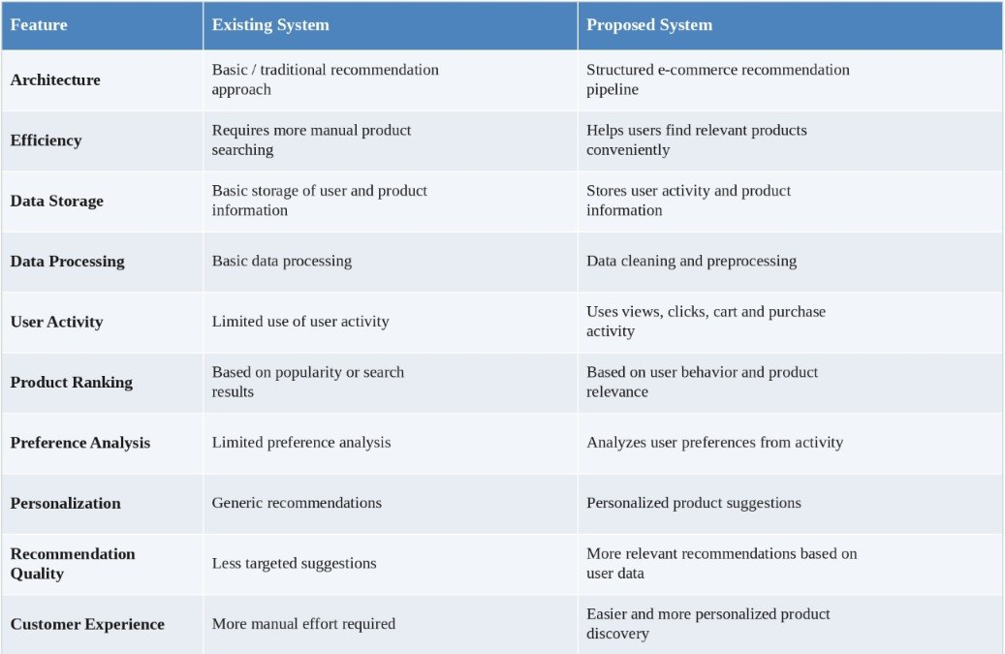
Comparison

Slide 25
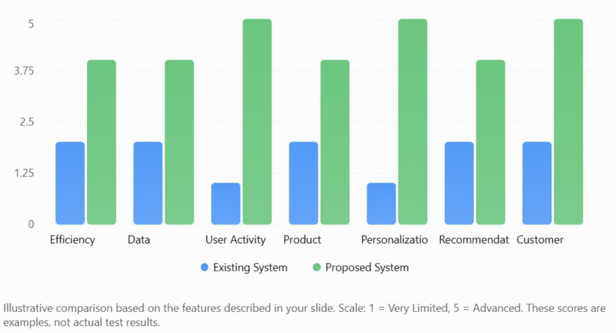
Comparison

Slide 26
Discussion
Point | Amazon-style system (existing) | Our system (ALS, synthetic data)
How it recommends | "People who bought this also bought that" | Learns each user's taste and predicts what they'll like
Speed (2K records) | Slower, about 3.8 s* | Faster, about 1.1 s*
Records per second | About 520* | About 1,790*
Prediction error (RMSE) | Higher (about 1.75)* | Lower (about 1.45)*
Correct recommendations in top 10 | About 1 in 1,000* | About 4 in 1,000*
Data cleaning | Done by hand, partly* | Done automatically
Personalization | Mostly same picks for many people | Different picks for each user
New users | Struggles, shows popular items | Also needs some data, but learns quickly once they rate items

Slide 27
Conclusion
The E-Commerce Recommendation Pipeline provides a structured approach for generating personalized product recommendations.
The system collects user and product activity data, cleans and preprocesses the information, analyzes customer interests, identifies relevant products, and ranks them according to user preferences and product relevance.
The project demonstrates how data processing and recommendation techniques can be used to improve product discovery, personalization, and customer experience in e-commerce platforms.

Slide 28
References
Adomavicius & Tuzhilin (2005): Surveyed recommender systems and their evolution.
Linden et al. (2003): Introduced Amazon’s item-to-item recommendation approach.
Hu et al. (2008): Focused on recommendations using implicit user feedback.
Koren et al. (2009): Explained matrix factorization for personalized recommendations.
Covington et al. (2016): Applied deep learning to YouTube recommendations.
He et al. (2017): Proposed neural collaborative filtering for better recommendations.

Slide 29
THANK YOU

